Slide 1
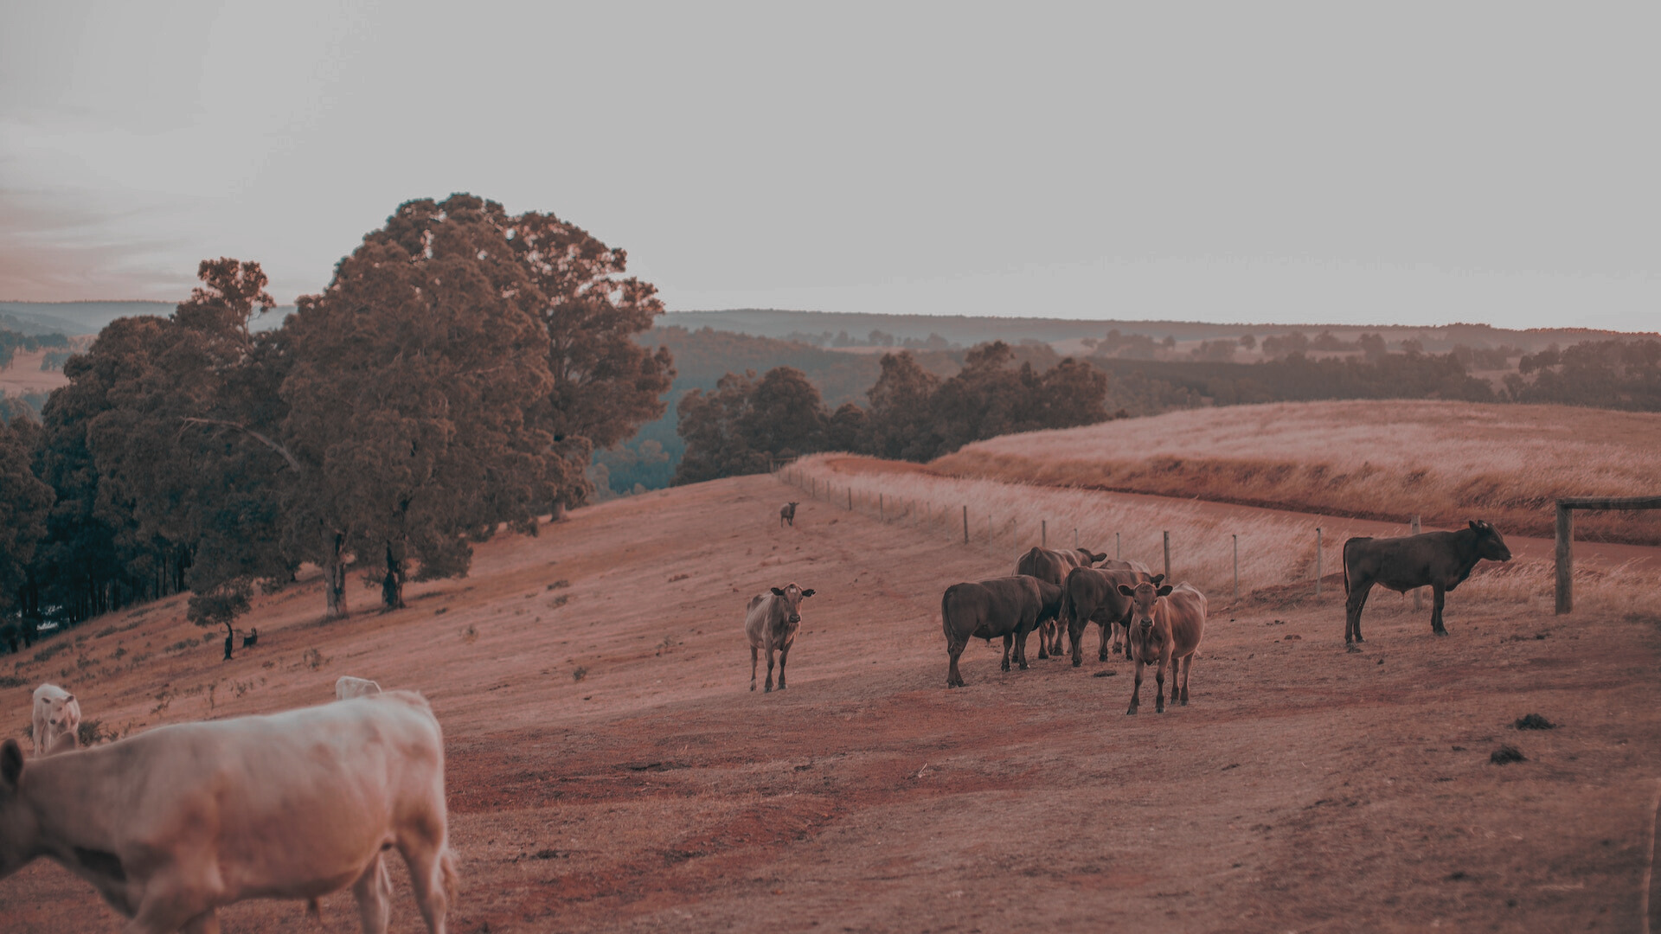
PSIT
Bachelor of Technology
CSE(2022 - 23)
Project ID:
23 A 19
COW BREED CLASSIFICATION
Submitted by: Ankit Kumar(1901640100054), Atharva Vishwakarma(1901640100082),
Avanish Dubey (1901640100083), Sana Siddiqui (1901640100233)

Slide 2
TABLE OF CONTENTS
01
Introduction
05
Flowchart
02
Objective
06
Technology Used
03
Methodology
07
Results
04
Transfer Learning
08
Use Cases & Conclusion

Slide 3
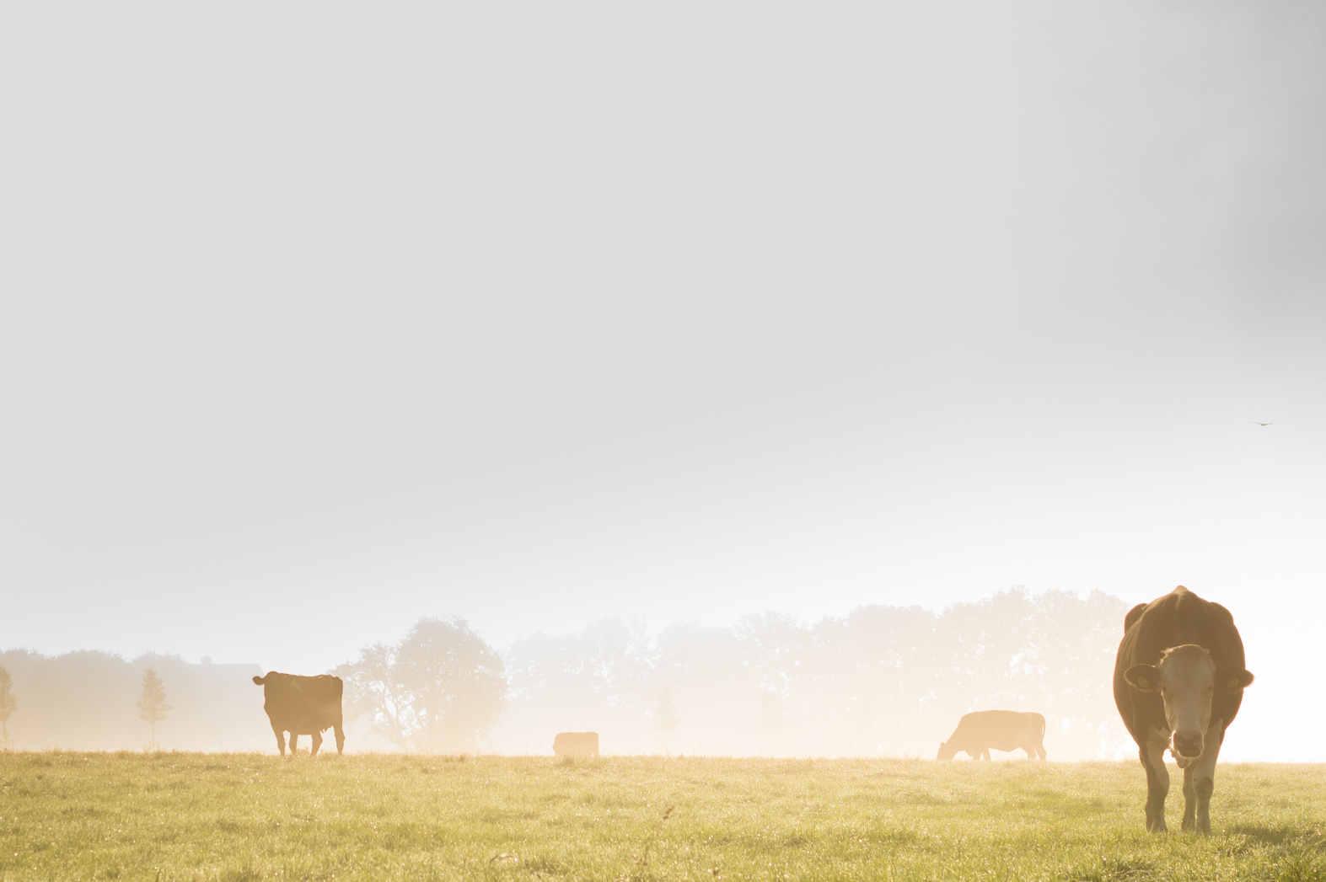
INTRODUCTION
Cows are one of the most common and important domestic animals in the world. They provide humans with various products such as milk, meat, leather, and fertilizer.
Each breed has its own characteristics, such as size, color, shape, horns, milk production, and adaptability to different environments.
We propose a machine learning approach to automatically classify cows into different breeds based on their images.

Slide 4
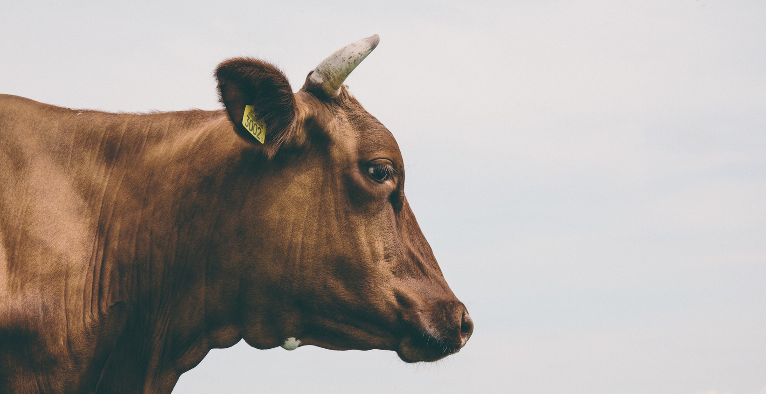
OBJECTIVE
The current system works on manual identification and classification of cow breeds by experts or farmers, using visual cues such as horns, humps, coat color and pattern, body size and shape, etc.
However, this system is prone to errors, inconsistencies, and subjectivity, especially when dealing with similar or mixed breeds.
Some studies have proposed computer vision-based approaches for automatic detection of dairy cow breeds, using image processing and machine learning techniques.

Slide 5

METHODOLOGY
start
1. Collect images of cows belonging to different breeds such as Gir, Sahiwal, Rathi and Red Sindhi from various sources
2. Preprocess the images to enhance their quality and reduce noise, such as by resizing, cropping, rotating, filtering and augmenting them.
3. Split dataset into Training, Testing & Validation part.
4. Building the model using the pretrained model Inception-v3.

Slide 6
5. Compile the Model.
6. Train a classifier using the selected features and a labeled dataset of cow images with their corresponding breeds.
7. Evaluate the performance of the classifier using metrics such as accuracy, precision and try to improve it.
8. Integrate the ML model on the website that can allow users to upload their own images of cows.
end

Slide 7
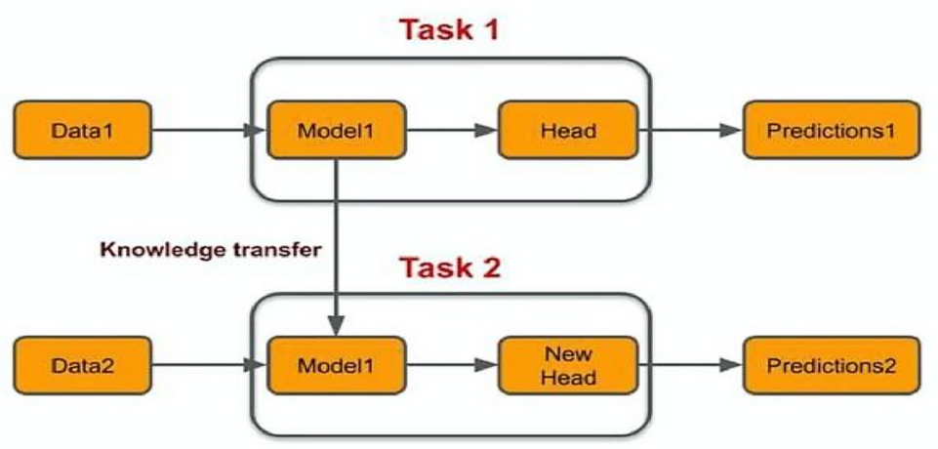
TRANSFER LEARNING
Transfer learning is a machine learning technique that involves reusing a pre?trained model on a new problem.
It is based on the idea that the knowledge gained from one task can be transferred to another related task, improving the performance and reducing the training time.

Slide 8
WHY TRANSFER LEARNING?
01
We don’t need a veery large amount of DataSet.
02
Useful task is similar to the previous task.
03
More efficient than new CNN models.
04
Takes lesser time to get trained and lesser computational power.

Slide 9
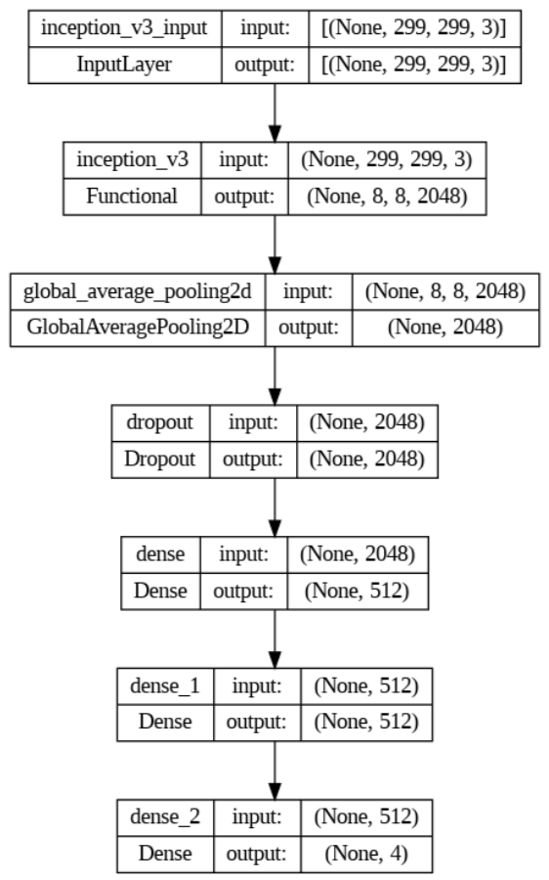
Layers of Training Model

Slide 10
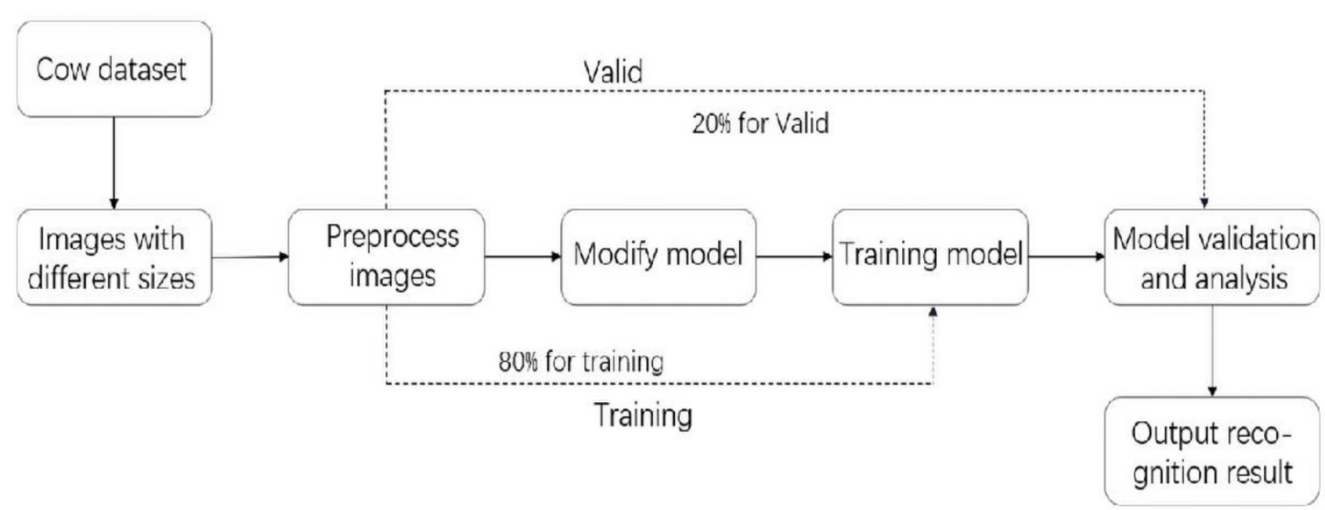
MODEL WORKING FLOW-CHART

Slide 11
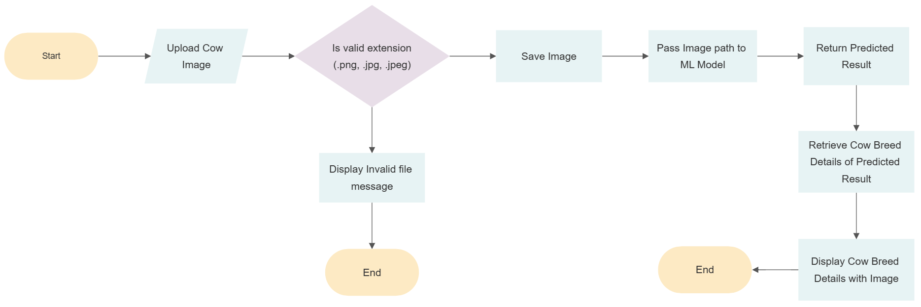
UPLOAD IMAGE WORKING FLOW-CHART

Slide 12
TECHNOLOGY USED
PYTHON
Python is a high-level, interpreted programming language. Python is commonly used in scientific computing and data analysis due to libraries like NumPy, Pandas, and Matplotlib.
Python's popularity has also surged in machine learning and artificial intelligence. Libraries such as TensorFlow, PyTorch, and scikit-learn provide powerful tools for developing machine learning models and performing deep learning tasks.

Slide 13
TECHNOLOGY USED
INCEPTION V3 MODEL
Inception v3 is an image recognition model that has been shown to attain greater than 78.1% accuracy on the ImageNet dataset.
The model itself is made up of symmetric and asymmetric building blocks, including convolutions, average pooling, max pooling, concatenations, dropouts, and fully connected layers.

Slide 14
TECHNOLOGY USED
KERAS
Keras is an open-source software library that provides a Python interface for artificial neural networks.
TENSORFLOW
TensorFlow is an open-source software library for dataflow and differentiable programming across a range of tasks. It is a symbolic math library and is also used for machine learning applications such as neural networks.

Slide 15
TECHNOLOGY USED
DJANGO FRAMEWORK
Django is a web framework that is written in Python and follows the model template-views (MTV) architectural pattern.
HTML & CSS
HTML (Hyper Text Markup Language) is a fundamental language for building web pages and applications. It provides a structured way to organize and present content on the World Wide Web.
CSS (Cascading Style Sheets) is a powerful language used to define the visual appearance and layout of web documents.

Slide 16
TECHNOLOGY USED
API
An Application Programming Interface (API) is a set of rules and protocols that allows different software applications to communicate and interact with each other.
SQLITE3 DATABASE
SQLite3 is a lightweight and self-contained database engine that can store data in a single file. It is the default database for Django projects and can be used for development and testing purposes.

Slide 17
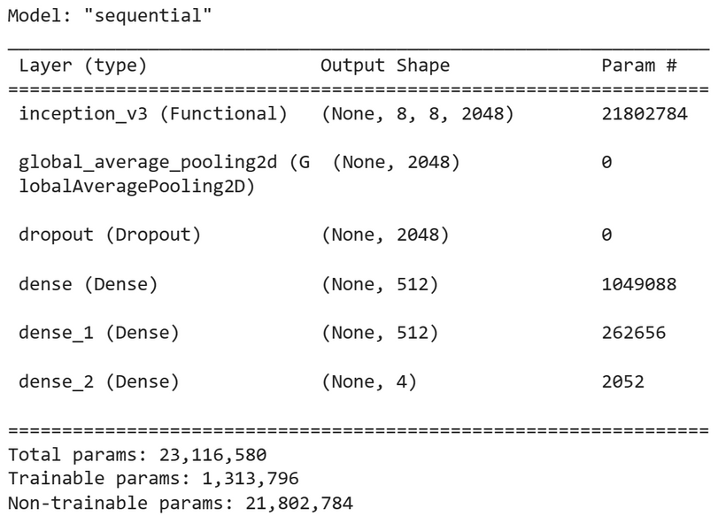
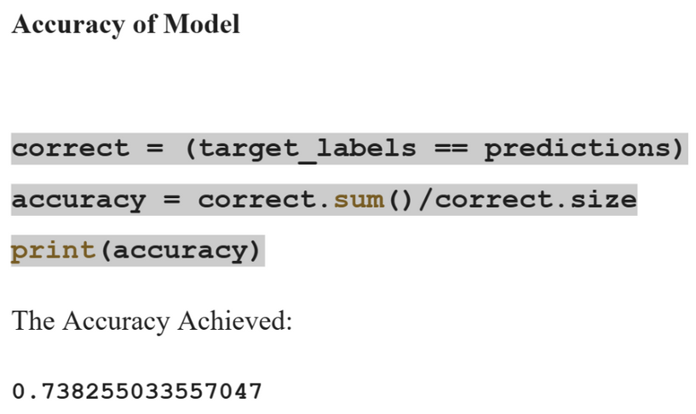
RESULT
Initialized Inception V3 Model
Model Accuracy

Slide 18
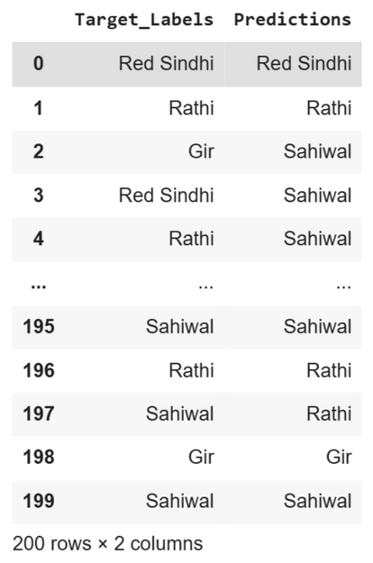
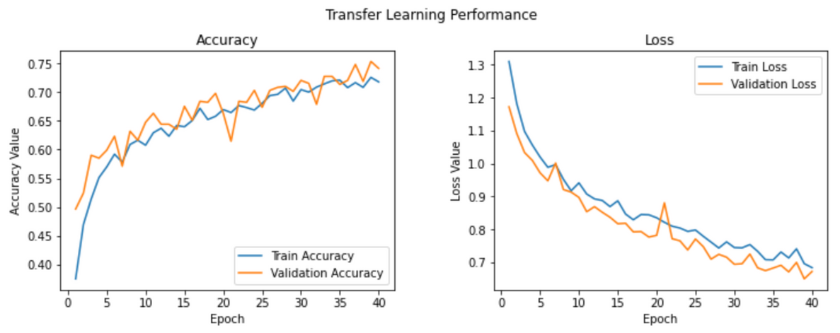
RESULT
Accuracy and Loss Function Graph
Target Label and Prediction Table

Slide 19
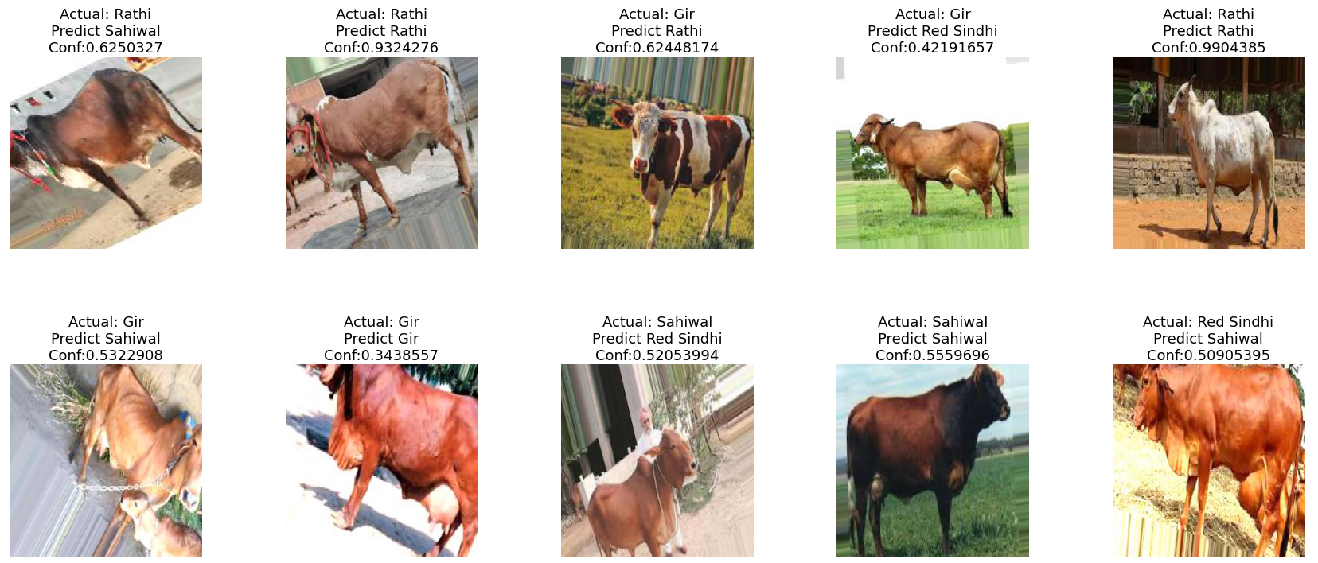
RESULT
Predicting Images along Their Confidence Level

Slide 20
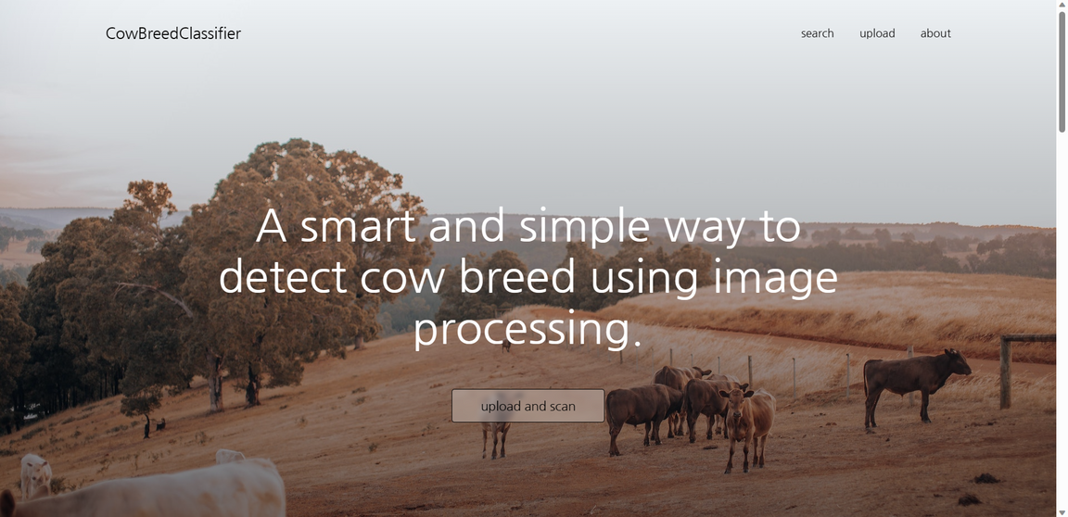
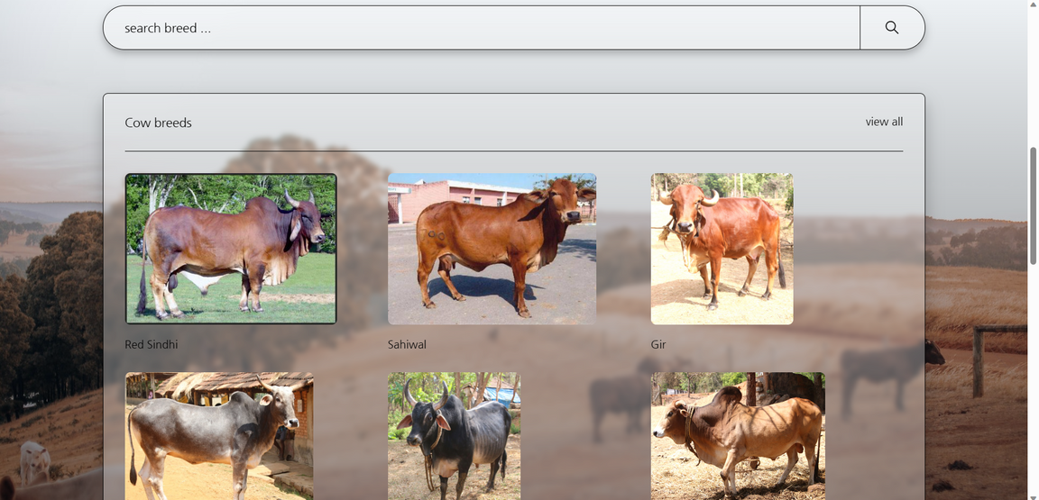
RESULT
Home page Screenshots

Slide 21
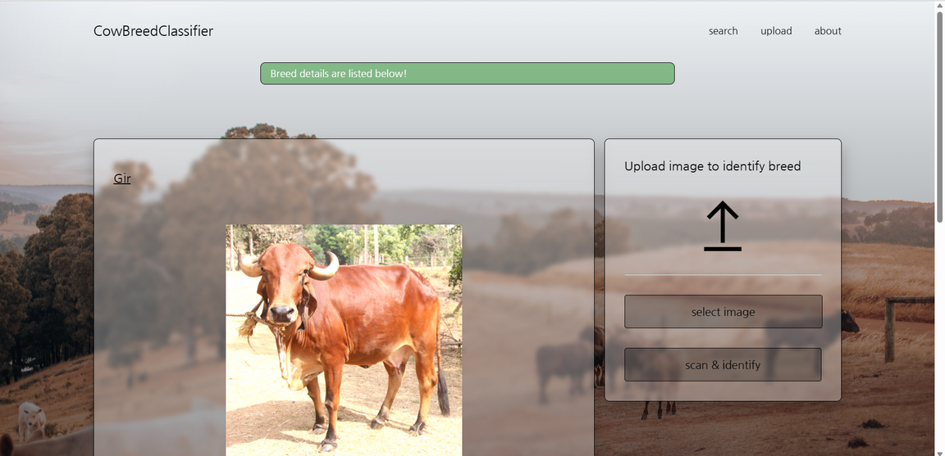
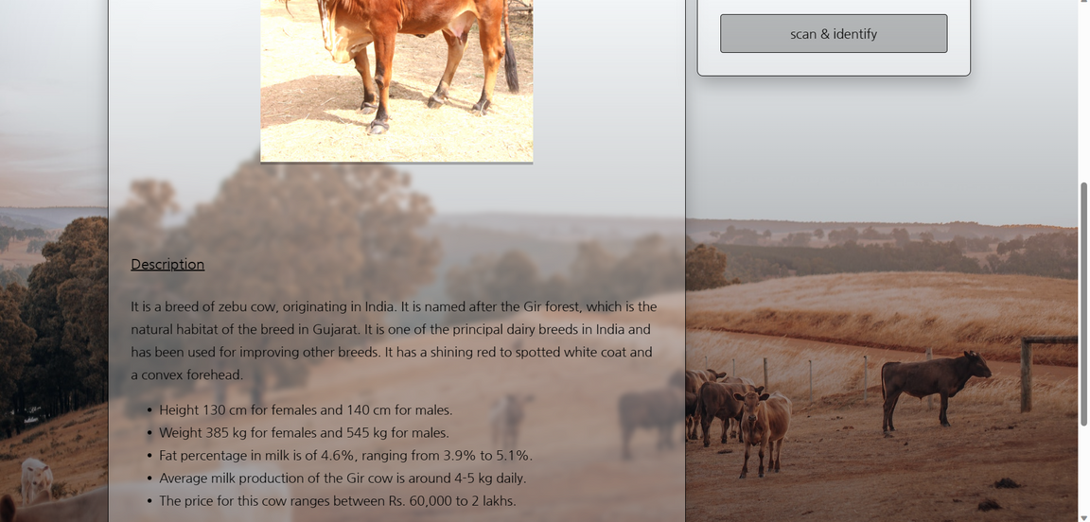
RESULT
Upload & Detail page Screenshots

Slide 22
USE CASES
1. Farmers and breeders to identify and classify their cattle breeds and manage their herd more efficiently and effectively.
2. Dairy producers to identify and classify their cattle breeds and optimize their milk yield and quality.
3. Onservationists and researchers to identify and classify the endangered or rare cattle breeds and preserve their genetic diversity. It can also help them to study the origin and evolution of cattle breeds and their adaptation to different environments.

Slide 23
CONCLUSION
The main aim of this model is to learn how to use a machine learning classification tool to classify cow breed images,
Present how the computer vision-based approaches are helpful for agriculture and farming sector, using image processing and machine learning techniques.
We aimed to improve the accuracy, stability and speed of cow identification.

Slide 24
THANK YOU !

